Slide 1
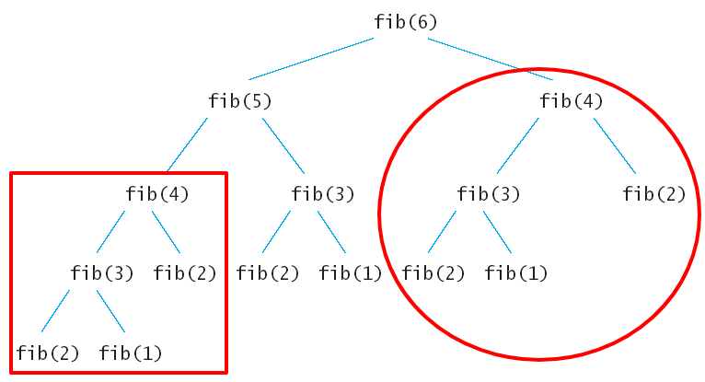
Dynamic Programming
Dynamic Programming is mainly an optimization over plain recursion.
Wherever we see a recursive solution that has repeated calls for same
inputs, we can optimize it using Dynamic Programming.
In this way, efficiency of the CPU can be enhanced.
Dynamic Programming = Memorization + Recursion
Example : Fibonacci series

Slide 2
In the above problem of solving fib(6), it was divided into sub problems fib(5) and fib(4), fib(5) is again divided into fib(4) and fib(3) and so on.. we can see that the same subproblem fib(4) is executed for more than one time making inefficient utilization of CPU.
‘If the sub problems are being executed more than one time why don’t we store the result somewhere on first computation itself and retrieve the same result when required’ this is how the Dynamic programming works.
DP is generally used to solve problems which involve the following steps
• Split the problem into multiple small subproblems and store results of the sub problem.
• While solving each subproblem, check if the same problem was solved earlier. If yes, then take the stored result instead of solving the same subproblem again.
• Merge the subproblem results into the final result.
As we are storing the answer of every subproblem for future use, it requires extra memory to save the data. This process is called as memorization.

Slide 3
Application of Dynamic programming
All Pairs Shortest Paths
Single Source Shortest Paths General Weights
Optimal Binary Search Tree
String Edition
0/1 Knapsack Problem
Reliability Design

Slide 4
1. All Pairs Shortest Paths
All pair shortest path algorithm is also known as Floyd-
Warshall algorithm is used to find all pair shortest
path problem from a given weighted graph.
Let G = (V, E) be a directed graph with n vertices.Let cost be a cost adjacency matrix for G such that cost(i,i)= 0,1< i < n. Then cost(i,j) is the length (or cost) of edge {i,j} if (i,j) ɛ E(G) and cost(i,j)= ∞ if i ≠j and (i,j) ɛ E(G).
The all-pairs shortest-path problem is to determine
a matrix A such that A(i,j) is the length of a shortest
path from i to j.
The matrix A can be obtained by solving n single-source problems using the algorithm ShortestPath

Slide 5
We can obtain a recurrence for A^{k}(i,j) using an argument similar to that used before.
A shortest path from i to j going through no vertex higher than k either goes through vertex k or it does not.
If it does, A^{k}(i,j) = A^{k-1}(i,k) +A^{k-1}(k,j).If it does not,then no intermediate vertex has index greater than k-1. Hence A^{k}(i,j)= A^{k-1}(i,j).
Combining we get A^{k}(i,j) = min {A^{k-1}(i,j),
A^{k-1}(i,k)+A^{k-1}(k,j)},k >=1

Slide 6
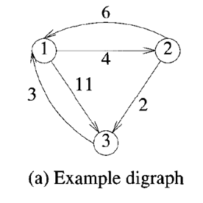
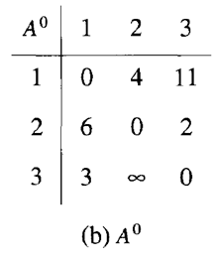
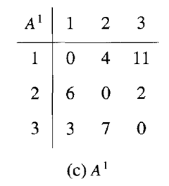
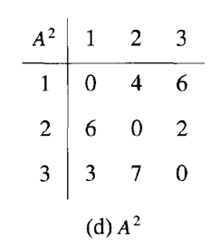
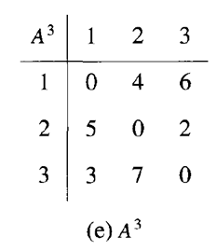
A^{k}(i,j) = min {A^{k-1}(i,j), A^{k-1}(i,k)+A^{k-1}(k,j)},k >=1
A¹(2,3)=min{A⁰(2,3),A⁰(2,1)+A⁰(1,3)}
=min{2,6+11}
=min{2,13}
=2
A¹(3,2)=min{A⁰(3,2),A⁰(3,1)+A⁰(1,2)}
=min{∞,3+4}
=min{∞,7}
=7
A²(1,3),A²(3,1) values are 6,3
A³(1,2),A²(2,1) values are 4,5
A³ is the all pairs shortest path.

Slide 7
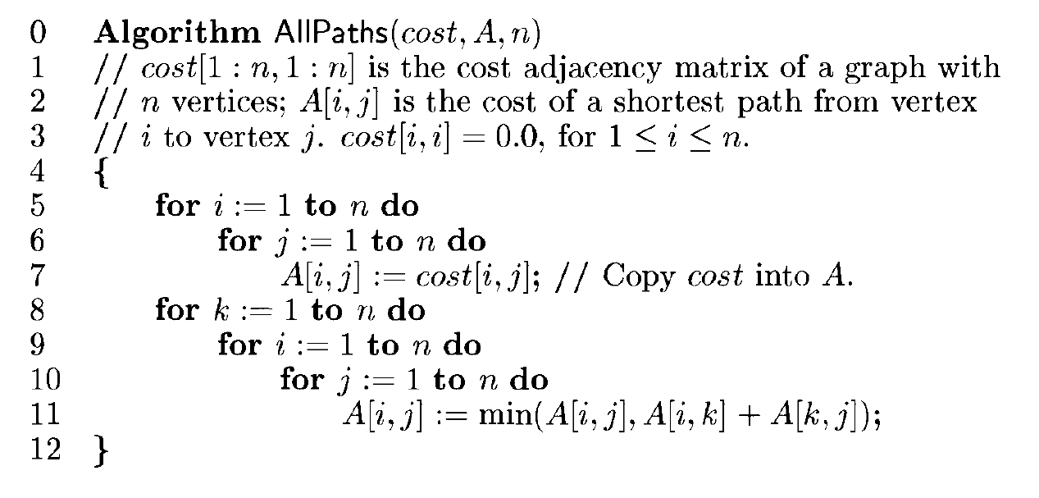

Slide 8

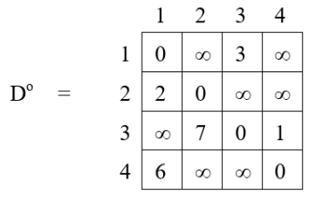
Time complexity for All pairs shortest path is
Apply Floyd’s method to find the shortest path for the below-mentioned all pairs.

Slide 9
2. Single Source Shortest paths General Weights
The idea is to use Bellman–Ford algorithm to compute the shortest paths from a single source vertex to all of the other vertices in given weighted digraph.
Bellman–Ford algorithm is slower than Dijkstra's Algorithm but it is capable of handling negative weights edges in the graph unlike Dijkstra's.

Slide 10
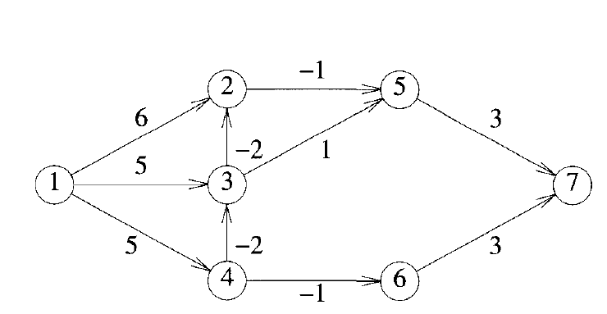
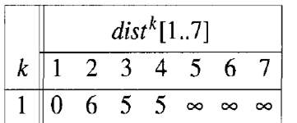

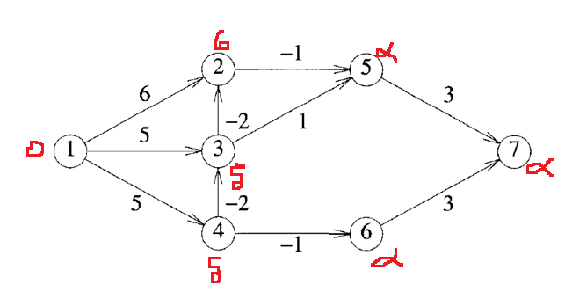
Step1:

Slide 11

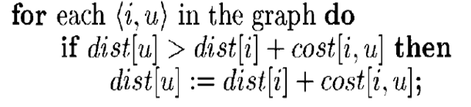

Step2:
Edges (1,2), (1,3),(1,4), (2,5), (3,2), (3,5), (4,3), (4,6) ,(5,7),(6,7)
Step3:
Step4:repeate step3

Slide 12
ii)
K=2 then
All the edges for second time on previously updated distances
Edges (1,2), (1,3),(1,4), (2,5), (3,2), (3,5), (4,3), (4,6) ,(5,7),(6,7)
For first edge (1,2)
d[2] > d[1] + c(1,2)
6 > 0+6 is false so no need to update distance of d[2]
For second and third edge (1,3) ,(1,4) will not be updated
edge (2,5)
d[5] > d[2] + c(2,5)
∞ >6 -1
∞ > 5 is true so update d[5] = 5
In Edges (3,2) (3,5) and (4,3) distances 3,5,3
In Edges (4,6) (5,7) and (6,7) distances 4,8,7

Slide 13
ii) K=3 then
All the edges on previously updated distances.
Edges (1,2), (1,3),(1,4), (2,5), (3,2), (3,5), (4,3), (4,6) ,(5,7),(6,7) are 0,1,3,5,2,4,5
ii) K=4 then
All the edges on previously updated distances .
Edges (1,2), (1,3),(1,4), (2,5), (3,2), (3,5), (4,3), (4,6) ,(5,7),(6,7) are 0,1,3,5,0,4,3
iii)K=5 then
All the edges on previously updated distances .
Edges (1,2), (1,3),(1,4), (2,5), (3,2), (3,5), (4,3), (4,6) ,(5,7),(6,7) are 0,1,3,5,0,4,3
iv)
K=6 then
All the edges on previously updated distances .
Edges (1,2), (1,3),(1,4), (2,5), (3,2), (3,5), (4,3), (4,6) ,(5,7),(6,7) are 0,1,3,5,0,4,3

Slide 14
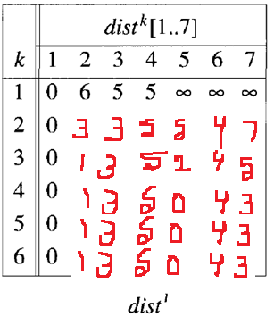

Slide 15
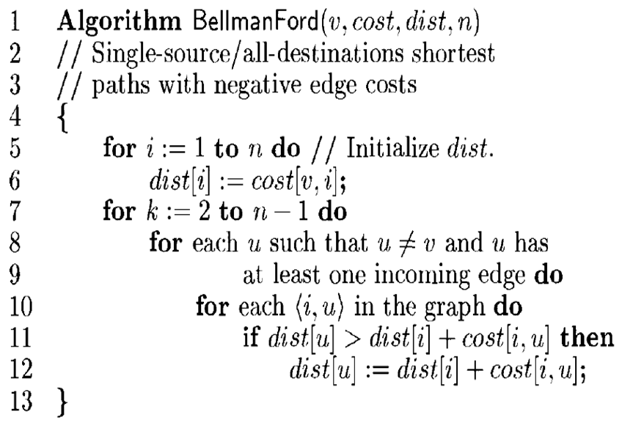

Slide 16
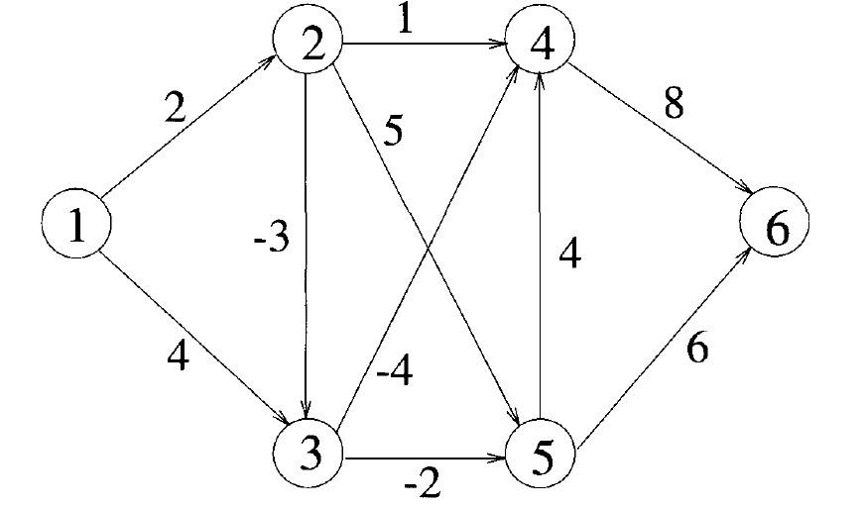
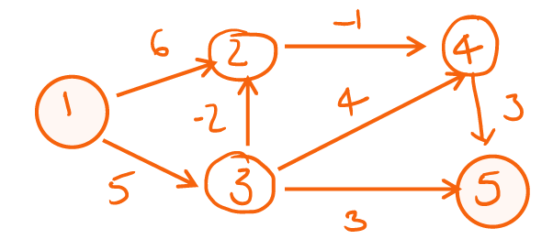
The overall complexity is O(n³)
Find the shortest paths from node1 to every other node in the following graphs Using the Bellman and Ford algorithm.

Slide 17
3. Optimal Binary Search Trees
Given a fixed set of identifiers, we wish to create a binary search tree.
We may expect different binary search trees for the same identifiers set to have different performance characteristics.
In a general situation, we can expect different identifiers to be searched for with different frequencies (or probabilities) .
Let us assume that the given set of identifiers is {a₁,a₂,….,a_{n}} with a₁ < a₂ < ….. <a_{n}.
Let p(i) be the probability of successful search.
Let q(i) be the probability of an unsuccessful search.
Given this data,we wish to construct an optimal binary search tree for {a₁,a₂,…..,a_{n}}

Slide 18
To apply dynamic programming to the problem of obtaining an optimal binary search tree,we need to view the construction of such a tree as the result of a sequence of decisions and then observe that the principle of optimality holds when applied to the problem state resulting from a decision.
A possible approach to this would be to make a decision as to which of the a_{i}'s should be assigned to the root node of the tree. If we choose a_{k}, then it is clear that the internal nodes for a₁, a₂,..a_{k-1} as well as the external nodes for the classes E₀,E₁,..,E_{k-1} will lie in the left subtree of the root. The remaining nodes will be in the right subtree.

Slide 19
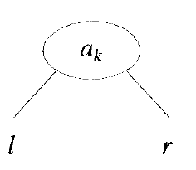
➢ w(i, j) denotes weight which can be defined using the following formula:
w (i, j) = p(j) + q(j) + w (i, j-1)
➢ c(i, j) denotes the cost matrix for OBST C(i, j) can be defined recursively, in the following manner:
c(i, j) = min {c (i, k-1) + c(k, j)} + w (i, j)
i<k<=j
➢ r(i,j ) = k value chosen among c(i, j)
➢ Initially c(i, i) = 0 ,r(i,i)=0 and w(i, i) = q(i) for 0 < i < n.
Example:
Let n = 4, and (a1, a2, a3, a4) = (do, if, int, while) Let p(1: 4) = (3, 3, 1, 1) and q(0: 4) = (2, 3, 1, 1, 1) .
optimal,we must have cost(l) = c(0,k-1) and cost(r)= c(k,n)

Slide 20
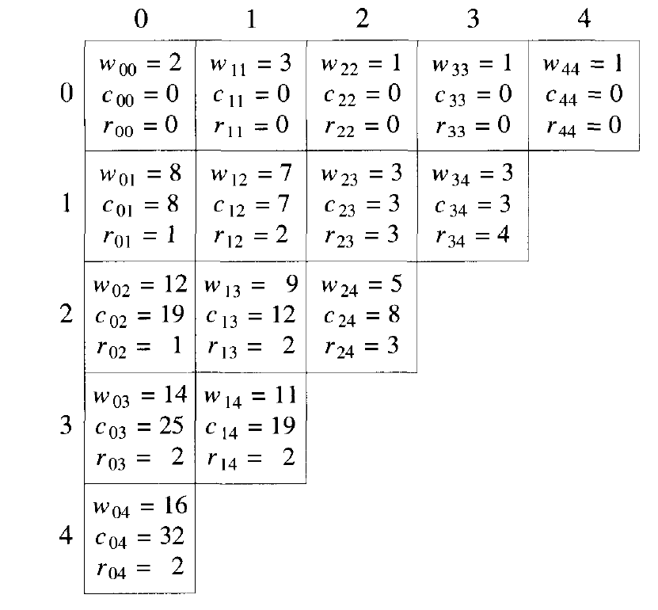
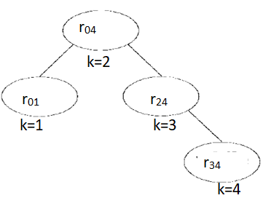
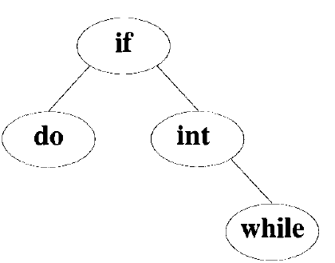
Table for recording w(i, j), c(i, j) and r(i, j)
Computation of c(0,4) ,w(0,4) and r(0,4)
Optimal search tree

Slide 21
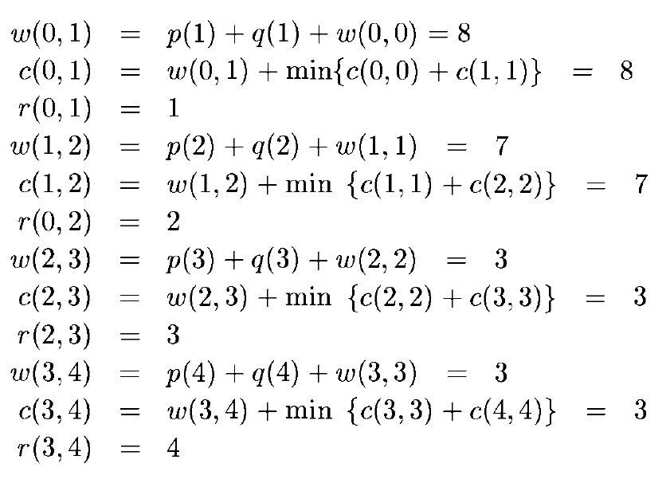

Slide 22
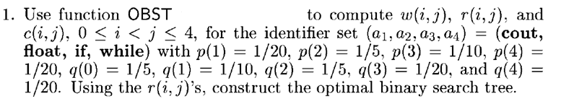
Time complexity is O(n²)

